Slide 1
Food and Beverages

Slide 2
About
Provide actionable insights to the Marketing Team in the Food & Beverage Industry.Key Problems Addressed:
Improving brand perceptionIdentifying the target audience
Determining locations to focus on
Gaining insights for product development
Defining an effective marketing strategy
Key Insights Derived:
Total number of responses
Price range preferences
Drink preferences by age group
Drink preferences by ingredient
Drink preferences by marketing channel
Reasons for drink consumption
Packaging preferences

Slide 3
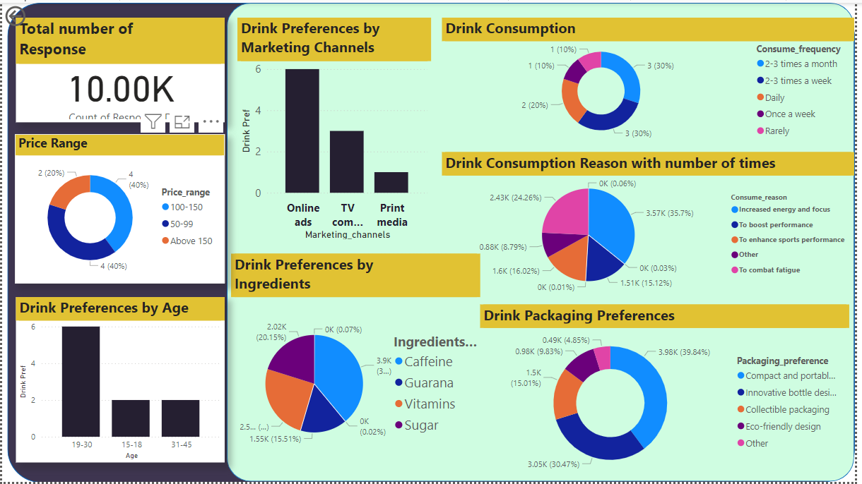

Slide 4
CONCLUSION
Focus on age groups with the highest drink preference.Tailor marketing messages based on popular consumption reasons
Develop new products or variations using popular ingredients.Optimize packaging based on consumer preferences.
Utilize preferred marketing channels to reach key segments effectively.
Utilize preferred marketing channels to reach key segments effectively.

